Slide 1

L-1 Ethics, ENRICHMENT AND impact in Scientific Writing Part 1
Research and Publication Ethics
Dr. Divya Singh
Designation- Associate Professor
divya.singh@mygyanvihar.com

Slide 2
Objective
. The students will understand basic concept of publication and ethics

Slide 3
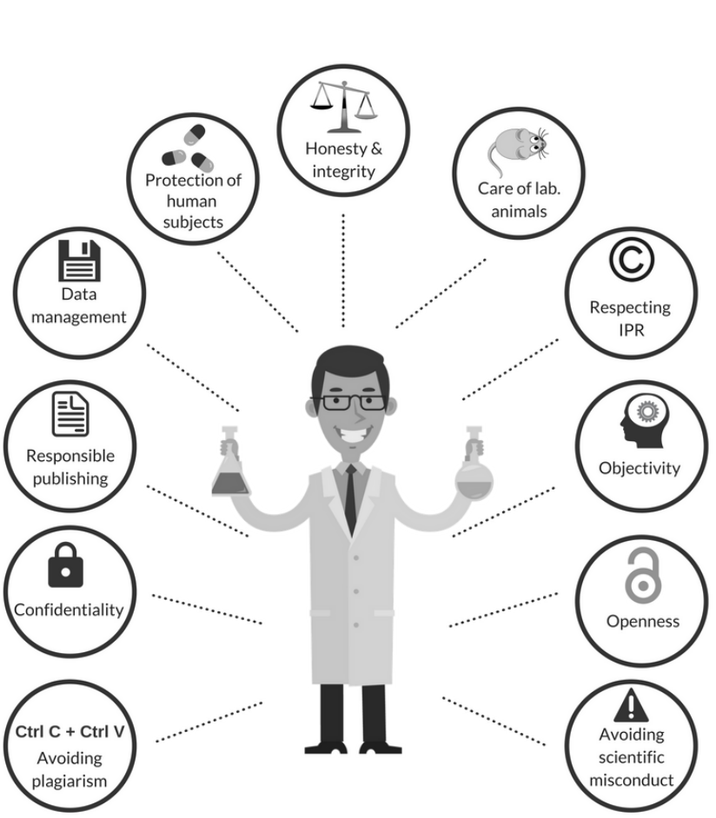

Slide 4
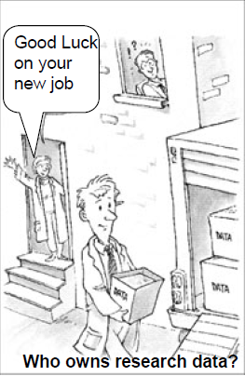

Scientific Paper writing
A scientific paper is a written and published report describing original research results.
An accepted original scientific publication containing scientific information.
A scientific experiment is not complete until the results have been published and understood.
A scientific paper is a paper organized to meet the needs of valid publication

Slide 5
- A Scientific paper is an organized description of hypotheses, data and conclusions, intended to instruct the reader. If your research does not generate papers, it might just as well not have been done”
(G. Whitesides, Adv. Mater., 2004, 16, 1375)
“If it wasn’t published, it wasn’t done”
E.H. Miller 1993

Slide 6
Scientific Paper Format
A scientific paper is a written report describing original research results whose format has been defined by centuries of developing tradition, editorial practice, scientific ethics and the interplay with printing and digital publishing services.
Editorial practice
Publishing procedures
Scientific ethics

Slide 7
Organization of a paper
The IMRAD Format
Most scientific papers are prepared according to a format called IMRAD.
The term represents the first letters of the words Introduction, Materials and Methods, Results, And, Discussion.
I = Introduction,
what problem was studied?
M = Methods,
how was the problem studied?
R = Results,
what are the findings?
A = and
D = Discussion,
what do these findings mean?
The most common is the IMRAD: If a number of methods were used to achieve directly related results:
M + R = Experimental section
The results are so complex that they need to be immediately discussed:
R + D = Results and Discussion section

Slide 8
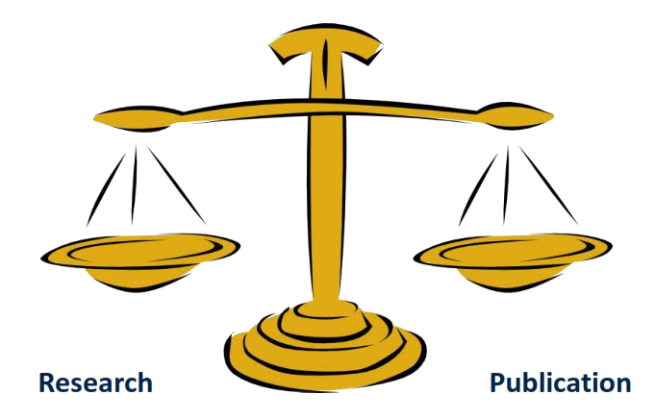
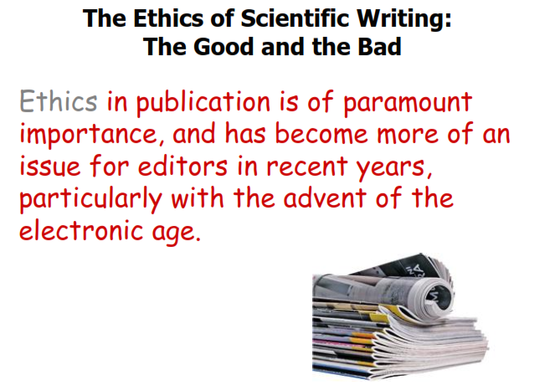
ETHICS OF SCIENTIFIC WRITING: THE GOOD AND BAD

Slide 9
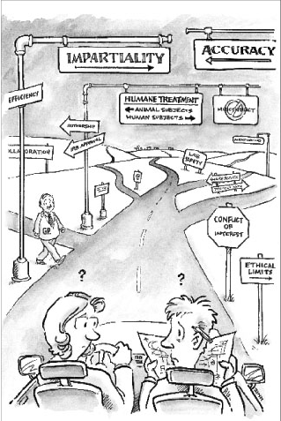
Setting off on the road
to
the responsible conduct of research

Slide 10
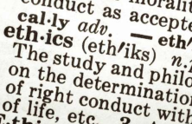
Originality
Not republishing the same findings (except under special circumstances, with the original source cited)
Not submitting the same manuscript to two or more journals at once
Not dividing one research project into many little papers (“salami science”)

Slide 11
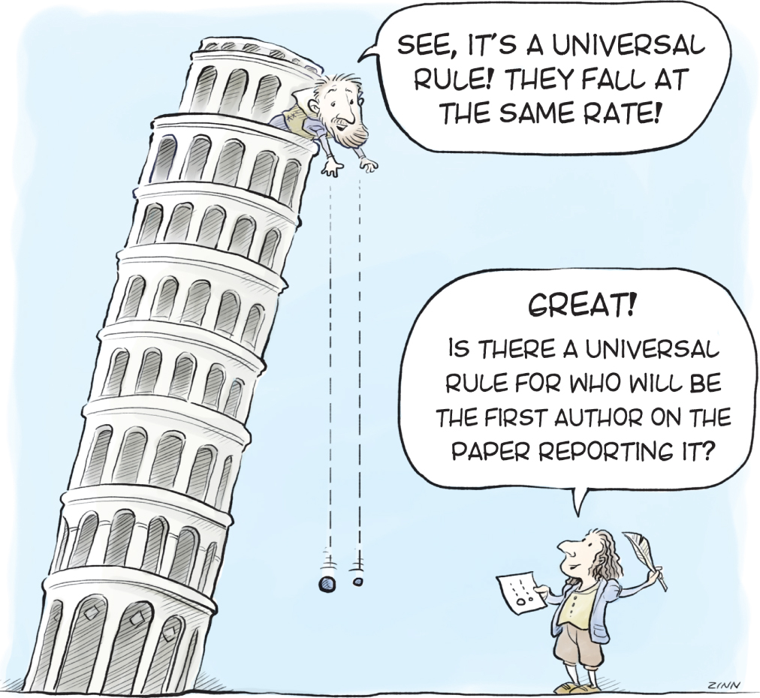
Research integrity
Includes:
the use of honest and verifiable methods in proposing, performing, and evaluating research.
reporting research results with particular attention to adherence to rules, regulations, guidelines, and following commonly accepted professional codes or norms (Ethics).

Slide 12
What can happen when research lacks integrity?
High Crimes
Research Misconduct
Plagiarism
Fabrication of data
Falsification of data
Debarment from receipt of agency funding
Supervision & certification of future research
Stop research
Termination
Cancel the degree
Formal reprimand and apology
Ethical training
Withholding pay

Slide 13
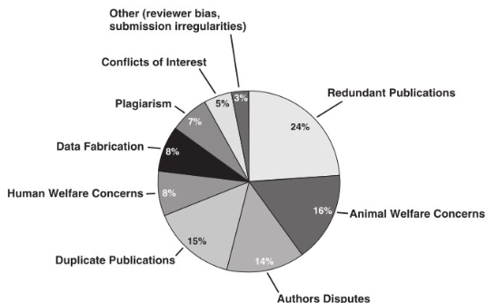
Distribution of ethical issues

Slide 14
Research Misconduct
(FFP)
Research misconduct is defined as fabrication, falsification, or plagiarism in proposing, performing, or reviewing research, or in reporting research results.
Fabrication is making up data or results and recording or reporting them.
Falsification is manipulating research materials, equipment, or processes, or changing or omitting data or results.
Plagiarism is the appropriation of another person’s ideas, processes, results, or words without giving appropriate credit.
Research misconduct does not include honest error or differences of opinion.
Research misconduct includes the destruction of, absence of, or accused person's failure to provide research records accurately documenting the questioned research.

Slide 15
Why People Plagiaries?
Lack of time / planning
Pressures to publish
(for career advancement)
To influence others
Competition
(parental & colleague pressure)
Fear of failure
Lack of
Enforcement
Laziness
Lack of knowledge
Notes:
What do you think of these excuses? Are they valid?

Slide 16
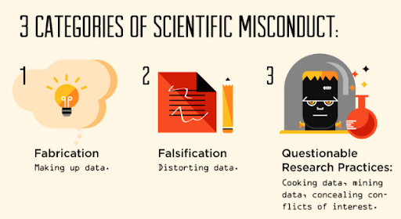

Slide 17
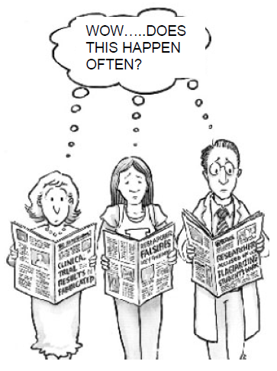
Data fabrication and falsification
→ Presenting fictitious data
→ Manipulation of data or experiments to obtain a desired outcome, or to avoid a non-desired outcome.
Problems:
Dilutes integrity of research
violating both the basic values and widely accepted professional standards of science.
- Wastes time of other scientists trying to replicate the research
- Decreases public trust in science/research

Slide 18
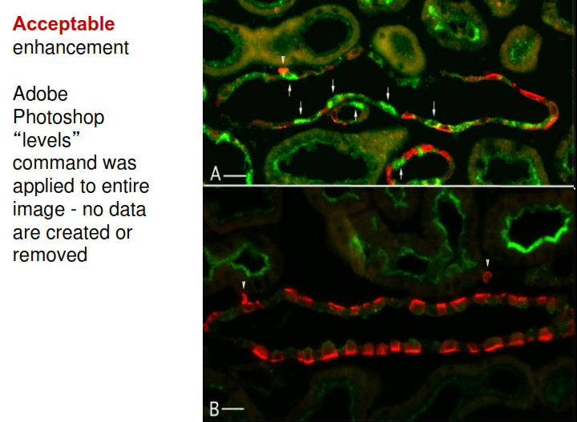

Slide 19
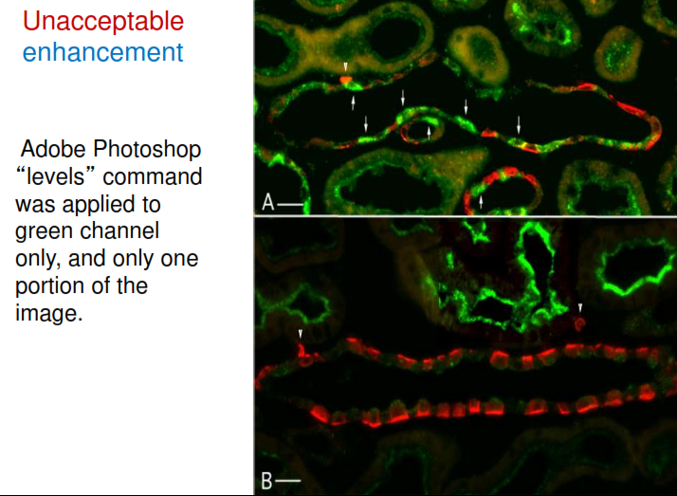

Slide 20

Plagiarism
Use of others’ published and unpublished ideas or words (or other intellectual property) without attribution or permission, and presenting them as new and original rather than derived from an existing source.
→ Misappropriation of intellectual property
→ Substantial unattributed textual copying of another's work
→ Includes the appropriation of ideas obtained by privileged communication (e.g. review process)
Some guidelines:
- Always acknowledge explicitly the origin of an idea
- If exact text is used, use quotation marks “ ...”
- If paraphrasing: understand the concept, then use your own wording
- Provide a reference if a fact or idea is not common knowledge

Slide 21
Quiz
Which principle of research ethics requires that participants are fully informed about the nature of the study and its potential risks?
A) Confidentiality
B) Informed Consent
C) Beneficence
D) Justice
What is the primary purpose of the principle of beneficence in research ethics?
A) To ensure research findings are published
B) To maximize benefits and minimize harm to participants
C) To protect the privacy of research participants
D) To provide participants with monetary compensation
Which ethical principle is concerned with fairness in the distribution of research benefits and burdens?
A) Integrity
B) Justice
C) Respect for Persons
D) Beneficence

Slide 22
What does the principle of confidentiality in research ethics primarily focus on?
A) Ensuring the research data is kept secure
B) Obtaining consent from participants
C) Providing financial compensation to participants
D) Avoiding conflicts of interest
Which of the following is NOT a requirement for obtaining informed consent?
A) Disclosure of the study’s purpose
B) Explanation of the risks and benefits
C) Assurance of a monetary reward
D) Assurance of the participant’s right to withdraw
What is the primary role of an Institutional Review Board (IRB) in research?
A) To fund research projects
B) To review and approve research protocols to ensure ethical standards
C) To recruit participants for studies
D) To publish research findings
Which ethical principle is violated if a researcher falsifies data?
A) Beneficence
B) Integrity
C) Justice
D) Confidentiality

Slide 23
What is the main goal of debriefing in research studies?
A) To collect additional data from participants
B) To inform participants about the true nature of the study after their participation
C) To compensate participants for their time
D) To modify the research study's design
Which of the following is considered a vulnerable population in research ethics?
A) College students
B) Adults with full cognitive ability
C) Prisoners
D) Healthy volunteers
Which ethical principle ensures that research results are reported honestly and transparently?
A) Beneficence
B) Justice
C) Integrity
D) Respect for Persons
What does the term “dual role” in research ethics refer to?
A) Having multiple research grants
B) A researcher having more than one role, such as both therapist and researcher
C) Publishing in multiple journals
D) Working on multiple projects simultaneously

Slide 24
Which principle requires researchers to avoid harm and protect participants from potential risks?
A) Justice
B) Respect for Persons
C) Beneficence
D) Integrity
What should researchers do if a study involves deception?
A) Ensure participants are never informed of the deception
B) Obtain approval from the IRB and debrief participants afterward
C) Ignore the ethical implications as long as the research is significant
D) Compensate participants more generously
In which situation is it acceptable to breach confidentiality in research?
A) To publish findings that could harm a participant’s reputation
B) To prevent harm or danger to the participant or others
C) To share information with colleagues
D) When the research is publicly funded
Which principle is concerned with respecting the autonomy of research participants?
A) Justice
B) Beneficence
C) Respect for Persons
D) Integrity

